Slide 1
Economics 187 Economic Forecasting
Lecture 16
Cointegration
Dr. Randall R. Rojas
Notes:
Note. If the Var model does not work, the cointegration might work.

Slide 2
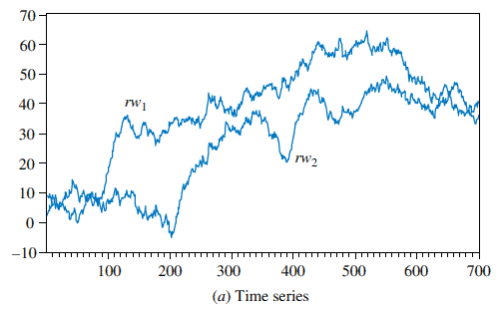
Spurious Regressions
In reality, rw₁ and rw₂ are
completely unrelated.
Random Walk 1 (rw₁):
Random Walk 2 (rw₂):

Slide 3
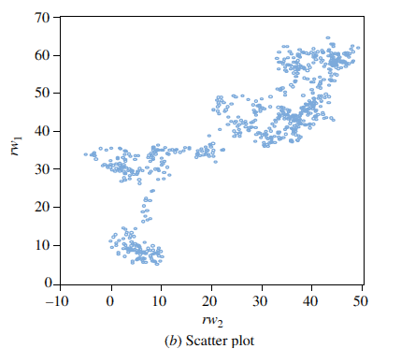
Spurious Regressions
Suppose we did not know that
rw₁ and rw₂ were unrelated, so
we fit a regression model.
A simple regression of series one
(rw₁) on series two (rw₂) yields:
These results are completely meaningless, or spurious.
The apparent significance of the relationship is false

Slide 4
Spurious Regressions
When nonstationary time series are used in a regression model, the results may spuriously indicate a significant relationship when there is none
In these cases the least squares estimator and least squares predictor do not have their usual properties, and t-statistics are not reliable.
Since many macroeconomic time series are nonstationary, it is particularly important to take care when estimating regressions with macroeconomic variables.

Slide 5
Unit Root Tests for Stationarity
There are many tests for determining whether a series is stationary or nonstationary
The most popular is the Dickey–Fuller (DF) test
There are three popular cases:
DF Test 1 (No Constant and No Trend): Δy_{t} = γy_{t-1} + e_{t}
DF Test 2 (With Constant but No Trend): Δy_{t} = α+ γy_{t-1} + e_{t}
DF Test 3 (With Constant and With Trend): Δy_{t} = α+ γy_{t-1} +λ_{t}+ e_{t}

Slide 6
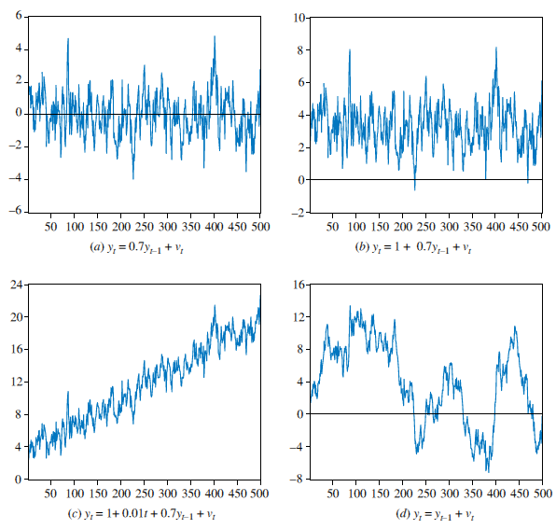
DF Test 1
DF Test 1
No Constant
and
No Trend
DF Test 2
DF Test 2
With Constant
but
No Trend
Constant=0

Slide 7
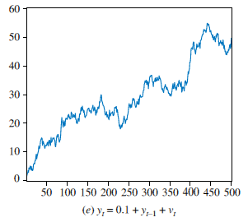
DF Test 3
DF Test 3
With Constant
and
With Trend

Slide 8
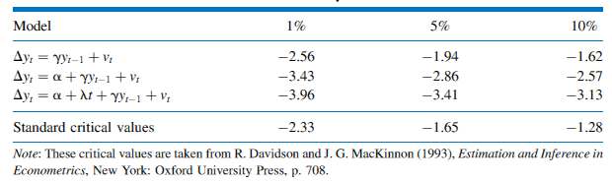
Unit Root Tests for Stationarity
To test the hypothesis in all three cases, we simply estimate the test equation by least squares and examine the t-statistic for the hypothesis that γ = 0.
Unfortunately this t-statistic no longer has the t-distribution.
Instead, we use the statistic often called a τ (tau) statistic.

Slide 9
Unit Root Tests for Stationarity
To carry out a one-tail test of significance, if τ_{c} is the critical value obtained from the DF Table, we reject the null hypothesis of nonstationarity if τ ≤ τ_{c}
If τ > τ_{c} then we do not reject the null hypothesis that the series is nonstationary
An important extension of the Dickey–Fuller test allows for the possibility that the error term is autocorrelated. These tests are referred to as augmented Dickey–Fuller (ADF) tests.
When γ = 0, in addition to saying that the series is nonstationary, we also say the series has a unit root.
In practice, we always use the augmented Dickey–Fuller test.

Slide 10
The Dickey-Fuller Testing Procedure
Plot the time series of the variable and select a suitable Dickey-Fuller test based on a visual inspection of the plot
If the series appears to be wandering or fluctuating around a sample average of zero, use DF Test 1.
If the series appears to be wandering or fluctuating around a sample average which is nonzero, use DF Test 2.
If the series appears to be wandering or fluctuating around a linear trend, use DF Test 3.

Slide 11
Cointegration
When we can find a linear combination of integrated variables that is stationary, we say that these variables are cointegrated.
If y_{t} and x_{t} are cointegrated, we expect them to share similar stochastic trends.
Cointegration is the statistical notion that corresponds to the economic notion of equilibrium.

Slide 12
Cointegration
For example, assume y_{t} and x_{t} are nonstationary I(1) variables, then e_{t} = y_{t} - β₁ - β₂ x_{t} is a stationary I(0) process.
We can test whether y_{t} and x_{t} are cointegrated by using a Dickey-Fuller test (for stationarity) on the LS residuals (since we cannot observe e_{t}).
Basically, if the residuals are stationary, then y_{t} and x_{t} are cointegrated.

Slide 13
Cointegration
Def: Cointegration Relation y_{t}= β₁ - β₂ x_{t} +e_{t}
Def: Disequilibrium Error e_{t} measures how far the system y_{t,} x_{t} is from the equilibrium path.
Equilibrium: e_{t}=0
Disequilibrium: e_{t} >0 or e_{t}<0
For Stationary data we can use models that capture short-term features.
For Non-Stationary data we can use models that capture long-term features.
Q: How can we integrate short- and long-term dynamics in a time series?
A: The Error Correction Model (based on cointegration)

Slide 14
Cointegration
The test for stationarity of the residuals is based on the test equation:
The regression has no constant term because the mean of the regression residuals is zero.
We are basing this test upon estimated values of the residuals.
The rhs of the equation can include higher order lags if needed to eliminate any dynamics in v_{t}.

Slide 15
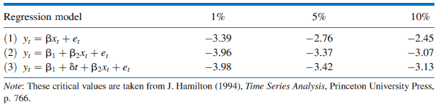
Cointegration
There are three sets of critical values
Which set we use depends on whether the residuals are derived from:

Slide 16
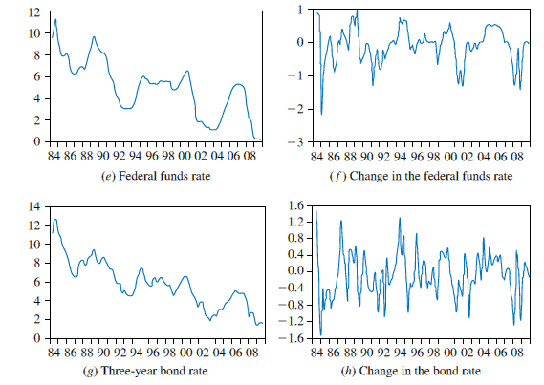
Cointegration
As an example, consider the two interest rate series (both are non stationary I(1)):
The federal funds rate (Ft)
The three-year bond rate (Bt)

Slide 17
Cointegration
Consider the estimated model:
The unit root test for stationarity in the estimated residuals is:
Use Equation 2 since:

Slide 18
Cointegration
The null and alternative hypotheses in the test for cointegration are:
Similar to the one-tail unit root tests, we reject the null hypothesis of no cointegration if τ ≤ τc, and we do not reject the null hypothesis that the series are not cointegrated if τ > τc.
Result: Reject H₀→Federal Funds and Bond Rates are cointegrated!
Implication: It means that when the Fed implements monetary policy by changing the federal funds rate, the bond rate will also change thereby ensuring that the effects of monetary policy are transmitted to the rest of the economy.
Notes:
It is easier to do a z-score and then do a cointegration since the values might be one notch higher. Try with FTSE, SP500, DAX, Australian market, China market, japan market, KLSE.

Slide 19
Error Correction Equation
Consider a general model that contains lags of y_{t} and x_{t}.
Namely, the autoregressive distributed lag model (ARDL), except the variables are nonstationary:
where v_{t} are the residuals.

Slide 20
Error Correction Equation
If y_{t} and x_{t} are cointegrated, it means that there is a long-run relationship between them
To derive this exact relationship, we set
y_{t} = y_{t-1} = y, x_{t} = x_{t-1} = x and v_{t} = 0
Imposing this concept in the ARDL, we obtain:
y = β₁ + β₂ x, where β₁ = δ/(1-θ₁) and β₂ = (δ₀+δ₁)/(1-θ₁)
Cointegrating (or long-run)
relationship between x and y
Notes:
Looking at the long run, if it reaches a stead state/equilibrium, the error will be 0 and thus the equation, y = B1+B2x is true.

Slide 21
Error Correction Equation
Add the term -y_{t-1} to both sides of the equation:
Add the term – δ₀x_{t-1}+ δ₀x_{t-1}:
Manipulating this we get:

Slide 22
Error Correction Equation
The expression is called an error correction equation
This is a very popular model because:
It allows for an underlying or fundamental link between variables (the long-run relationship).
It allows for short-run adjustments (i.e. changes) between variables, including adjustments to achieve the cointegrating relationship.
It also shows we can work with I(1) variables (y_{t-1},x_{t-1}) and I(0) variables (Δy_{t-1},Δx_{t-1}) in the same equation .

Slide 23
Error Correction Equation
For the bond and federal funds rates example, we have:
The estimated residuals are

Slide 24
Error Correction Equation
The result from applying the ADF test for stationarity is:
Comparing the calculated value (-3.929) with the critical value, we reject the null hypothesis and conclude that (B, F) are cointegrated.

Slide 25
For Next Class
Readings about today’s class:
Chapter 12ª
Review Exercises / Problems:
Chapter 13ª: 1, 3, 5, 6
Readings for next class:
Special Topics: State Space Models

